Slide 1
Presentation
Topic : BCD CODE
Subject : computer fundamentals
Submitted by : Sunil
Submitted to : Hina mam
Roll no : 1615918
Class : B.Voc (SD) 1st year

Slide 2
BCD CODE
Binary coded decimal (BCD) code is one of the early computer codes. In BCD codes, each digit of a decimal number is represented by its binary equivalent of converting the entire decimal value to a binary number. This makes the conversion process easier.
Since 8 and 9 require 4 bits, all decimal digits are represented in BCD by 4 bits. We saw that 42₁₀ is equal to 101010₂.converting 42₁₀ into BCD however, produces the following result:
42₁₀=0100/4 0000/2 or 00010000 in BCD

Slide 3
Decimal number | BCD number
0 | 0000
1 | 0001
2 | 0010
3 | 0011
4 | 0100
5 | 0101
6 | 0110
7 | 0111
8 | 1000
9 | 1001

Slide 4
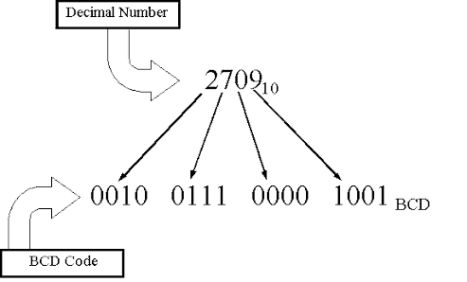

Slide 5
BCD- Binary Coded Decimal
When the Decimal number are represented in BCD, each decimal digit is represented by the equivalent BCD code.(4 BITS PER DIGIT)
Example: BCD
Representation of decimal:
6349
6 | 3 | 4 | 9
0110 | 0011 | 0100 | 1001

